Slide 1
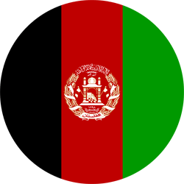
Afghanistan

Slide 2
Group Members: Asad Ali (191370095) Zainab (191370105) Sajjad Khalid (191370071) Muzammil (191370118) Sufyan Ahmed (201890013) Syed Nabeel Sharazi (191400002)

Slide 3
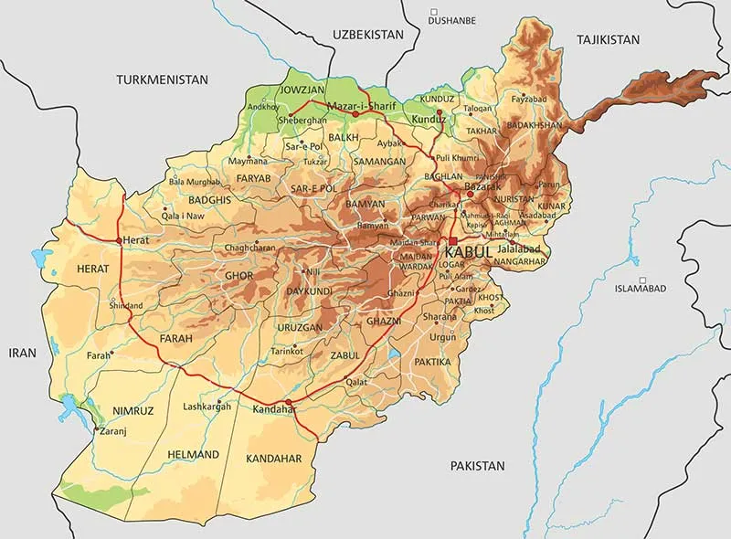
Geography
Afghanistan is located in South Asia and Central Asia, bordered by Pakistan to the east and south, Iran to the west, Turkmenistan, Uzbekistan, and Tajikistan to the north, and China to the northeast. It is a landlocked country with a varied geography, including high mountain ranges (including the Hindu Kush and the Pamir Mountains), deserts, fertile plains, and valleys. The Amu Darya and the Helmand River are two of the most significant rivers in the country. The climate is primarily arid to semi-arid, with cold winters and hot summers in the high mountain areas and hot, dry summers and mild winters in the low-lying areas. The jagged mountain peaks are treacherous, and are snow covered for most of the year. The country is the 40th largest in the world in size.

Slide 4
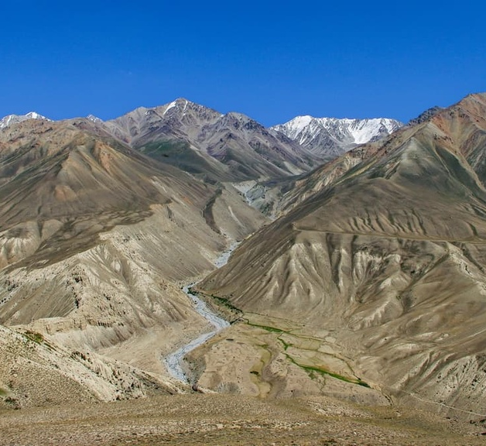
Area of Afghanistan:
The area of Afghanistan is approximately 652,860 km² (249,935 square miles).
Population of Afghanistan:
As of 2021, the estimated population of Afghanistan is 40.1 million people.

Slide 5
Source of Trade of Afghanistan
Exports
Imports
Bilateral Trade agreements
Informal Trade
Afghanistan's main exports include fruits and nuts, precious stones, wool, and hand-woven carpets.
Afghanistan imports a wide range of goods, including fuel, machinery, chemicals, and food products.
Afghanistan has signed a number of bilateral trade agreements with other countries, including the United States, India, and China, which aim to increase trade and investment between the countries.
Informal trade, such as smuggling and the illegal trade of goods and commodities, is a significant aspect of trade in Afghanistan and often operates outside the formal legal and regulatory framework.

Slide 6
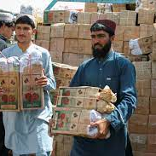
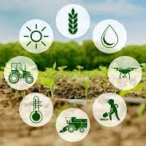

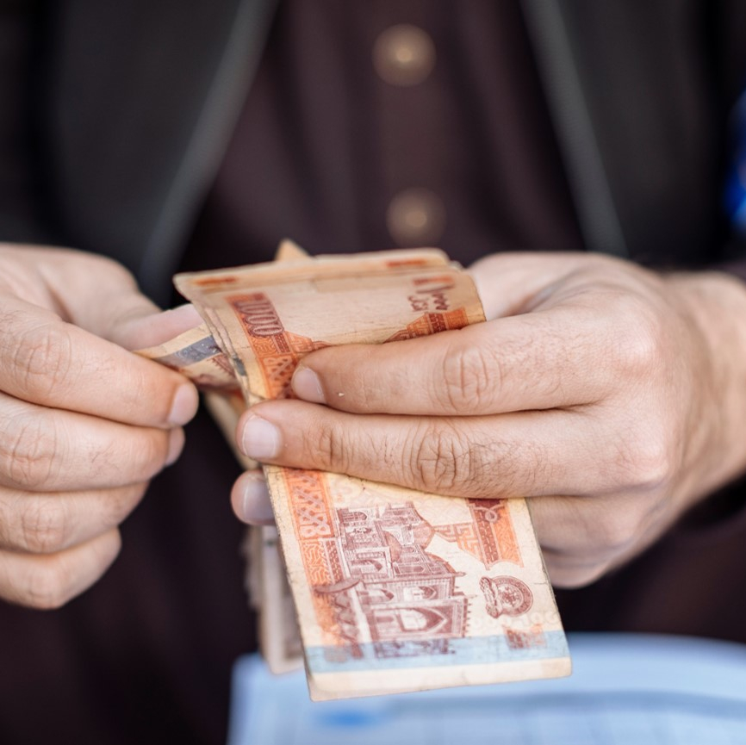
Source of Income of Afghanistan
International aid
Agriculture
Minerals and natural resources
Remittances
Afghanistan has received significant international aid since the fall of the Taliban regime in 2001. This aid has been used to support reconstruction and development efforts in the country, as well as to fund security and governance initiatives
Agriculture is a major source of income for many Afghan families and a significant contributor to the country's economy. Afghanistan is well-known for its high-quality fruits and nuts, and also produces wheat, cotton, and other crops.
Afghanistan has significant reserves of minerals, including copper, iron, gold, and oil. The development of these resources has the potential to provide a significant boost to the country's economy.
Many Afghan citizens work abroad and send money back to their families in the country. This remittance income is an important source of revenue for the Afghan economy.

Slide 7
Current President:
The current of Afghanistan was Ashraf Ghani
Vice President:
The Vice President of Afghanistan was Amrullah Saleh.

Slide 8
Important Political Parties of Afghanistan:
National Unity Government (NUG)
Jamiat-e Islami
Hezb-e Islami
Hezb-e Wahdat
Afghan Millat Party
Hezb-e-Afghan Mellat
Jumbesh-e Milli
Hezb-e-Afghanistan.
Afghan Social Democratic Party (Afghan Mellat)
Democratic Party of Afghanistan (DPA)

Slide 9
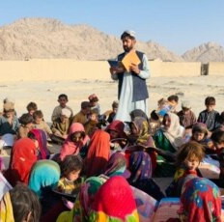
Scope of Education in Afghanistan
Education in Afghanistan has been growing in recent years, with an emphasis on increasing access to education for all citizens, especially women and girls.
Some of the main areas of study include the traditional subjects like literature, mathematics, and science, as well as vocational training and technical education

Slide 10



Job Opportunities Business in Afghanistan
As for jobs and business opportunities, Afghanistan has been undergoing a process of economic development since the fall of the Taliban regime in 2001
Despite ongoing security challenges, the country has seen significant growth in sectors like agriculture, construction, telecommunications, and mining. There are also opportunities in the service sector, including finance, healthcare, and education.

Slide 11
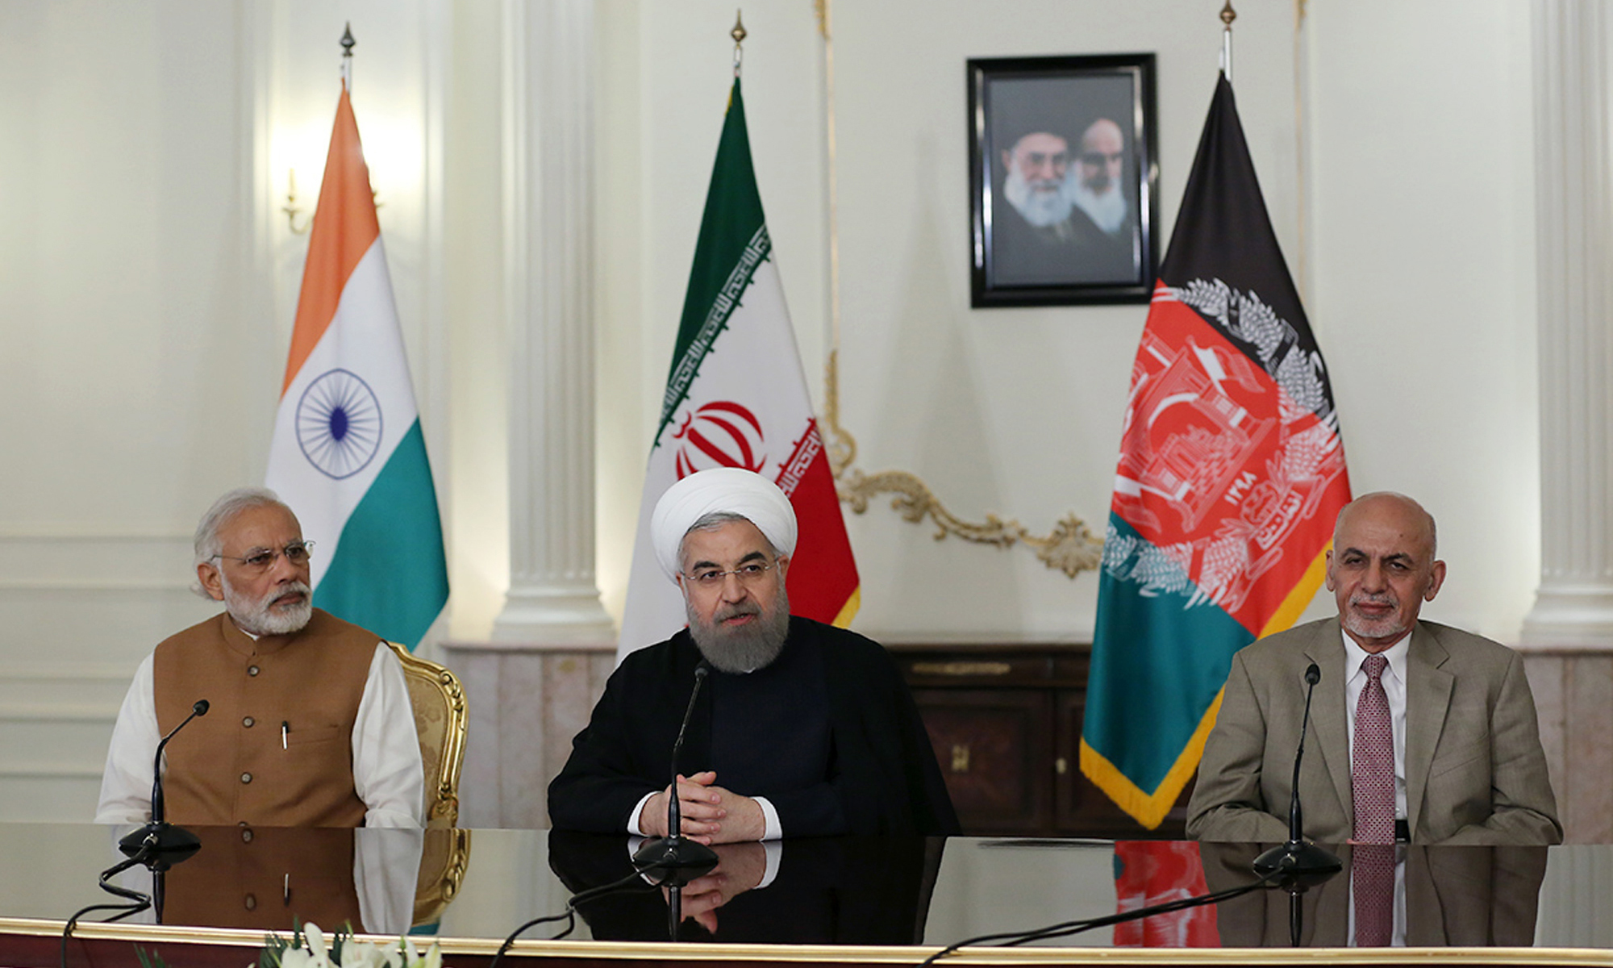
International Political Importance:
Geopolitical Location
Terrorism & Extremism
Regional Stability
Democracy & Human

Slide 12
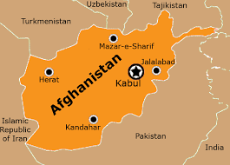
Geopolitical Location
Afghanistan is a country located at the crossroads of Central and South Asia, with a strategic location that has attracted great interest from various world powers.
12

Slide 13
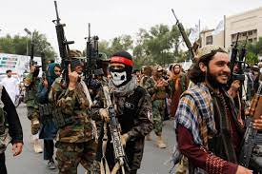
Terrorism & Extremism
Afghanistan has been a hotbed of terrorist activity, particularly since the rise of the Taliban in the 1990s. The country has been a safe haven for groups like Al Qaeda, who have used it as a base to plan and launch attacks against the West. The United States' intervention in Afghanistan in 2001 was driven by a desire to root out these extremist groups and prevent them from using the country as a launching pad for further attacks.

Slide 14
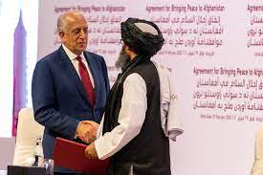
Regional Stability
Afghanistan's stability is crucial for the stability of the wider region. The country shares borders with Pakistan, Iran, Turkmenistan, Uzbekistan, and Tajikistan. Any instability in Afghanistan could have spillover effects in these neighboring countries, potentially leading to conflict, refugee crises, and other destabilizing factors.

Slide 15
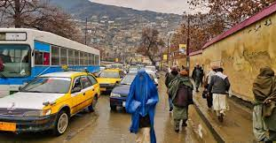
Democracy & Human
Since the fall of the Taliban, Afghanistan has made significant progress in establishing a democratic government and promoting human rights. The international community has a stake in ensuring that this progress is not reversed and that Afghanistan continues on a path towards greater democracy, stability, and respect for human rights.

Slide 16

Thank you!

